Slide 1
Natural Language Processing
Week 12

Slide 2
Good evening, everyone. Welcome to the live session.
Today, we will be practicing problems from the current week’s content.
We will wait 5 minutes for everyone to join in and start at 7:05 pm.

Slide 3
Question 1: Which of the following are indicators of Irrealis moods?
1. Words enclosed in quotes.
2. Conditional markers such as “If”.
3. Questions.
4. All of the above

Slide 4
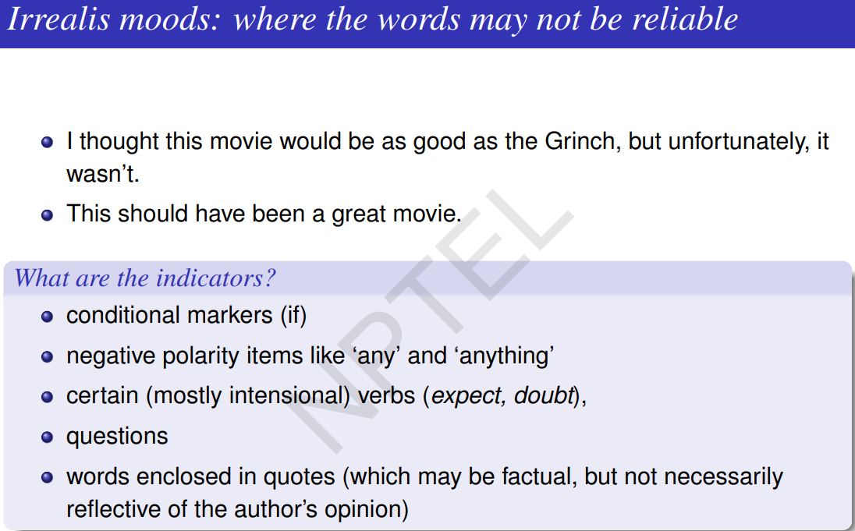
Solution
Answer:
4

Slide 5
Question 2: Let P(w|c) represent the probability of a word given its rating. Further, let P(w) represent the probability of the word in the overall corpus. While analyzing the polarity of a word in a given corpus, what is the intuition behind dividing P(w|c) by P(w)?
1. To make it comparable across different ratings.
2. To make it comparable across different words.
3. Both (1) and (2).
4. None of the above.

Slide 6
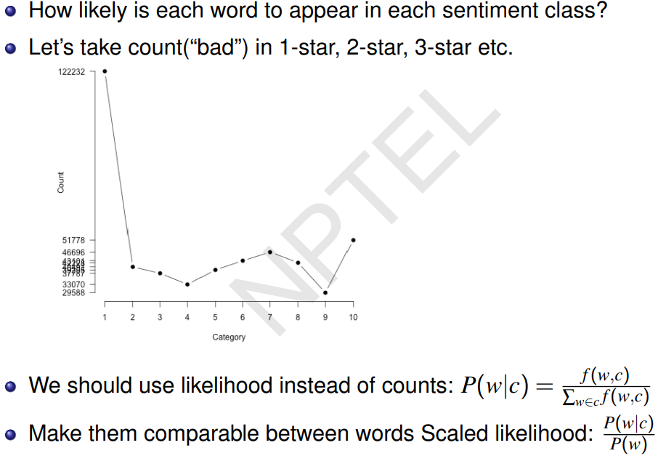
Solution
Answer: 2

Slide 7
Question 3: Which of the following lexicons are appropriate for valence?
1. Aroused, wide-awake
2. dominant, autonomous
3. happy, satisfied
4. stimulated, excited

Slide 8
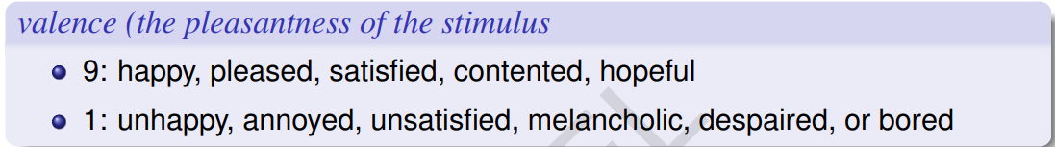
Solution
Answer: 3

Slide 9
Question 4: Which of the following is/are false?
1. The words ‘bad’, ‘problem’ represents negative emotion
2. The words ‘love’, ‘sweet’ belong to the class of affective processes
3. The words ‘perhaps’, ‘guess’ don’t belong to cognitive processes
4. ‘relaxation’ is an example of low arousal, high pleasure word

Slide 10
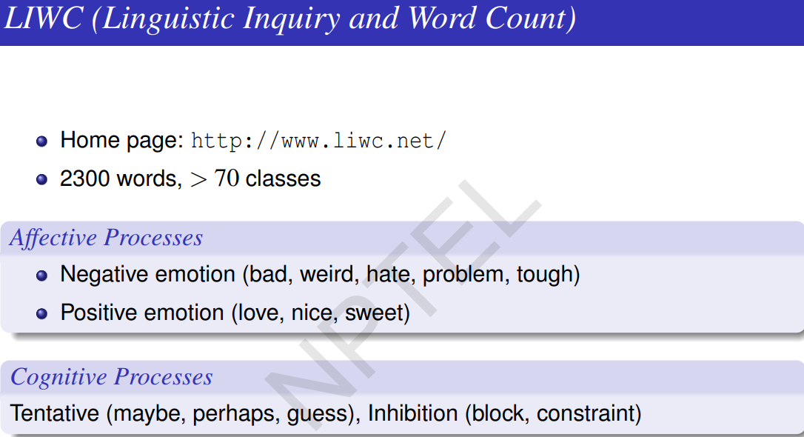

Slide 11
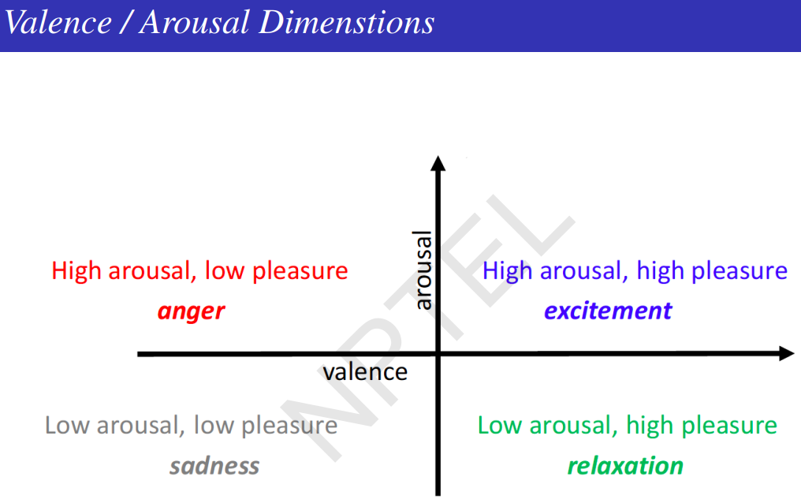

Slide 12
Solution
Answer: 3
Solution: ‘perhaps’, ‘guess’ they are under cognitive processes.

Slide 13
Question 5: Which of the following is/are correct about Turney Algorithm
1. It uses Pointwise Mutual Information measure
2. Jaccard Coefficient also an be used to measure the co-occurence
3. This is used for phrase polarity task
4. It learns polarity of only
a subset of phrase in the corpus

Slide 14
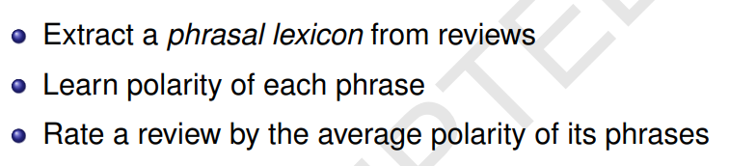
Solution
Answer: 1
Solution:

Slide 15
Question 6: Sentiment lexicons can be learned using intuitions such as:
1. Same polarity words are connected by “and”
2. Opposite polarity words are connected by “but”
3. Both (1) and (2)
4. None of the above

Slide 16
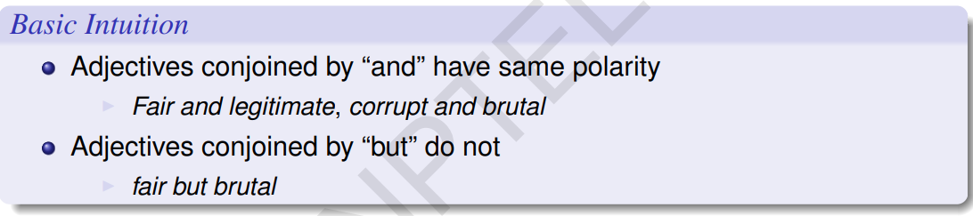
Solution
Answer: 3
Solution:

Slide 17
Question 7: Which of the following are true?
1. Emotions are instinctive and usually short-lived, whereas sentiments are more stable and valid for a longer period of time.
2. Polarity shift technique is performed to handle normalization problems
3. Sentiment lexicons can be learned using intuitions such as same polarity words are connected by “and.
4. 1 & 2

Slide 18
Solution
Answer: 1, 3
Solution: Polarity shift technique is performed to handle negations and intensifiers.

Slide 19
Question 8: Consider the sentence: “The sound was cool; but, the network quality and screen were very dull”. Which of the following are true?
1. Aspect: “sound”, Sentiment: Positive, Opinion Phrase: “cool”.
2. Aspect: “screen”, Sentiment: Negative, Opinion Phrase: “very dull”.
3. Aspect: “were”, Sentiment: Negative, Opinion Phrase: “very dull”.
4. Only (1) and (3)

Slide 20
Solution
Answer: 1,2
Solution: ‘were’ is not a aspect term

Slide 21
Question 9: Consider the sentence: “The environment was great, however rent was very costly”. Which of the following is/are true?
1. Aspect: “environment”, Sentiment: Positive, Opinion Phrase: “great”.
2. Aspect: “rent”, Sentiment: Negative, Opinion Phrase: “very costly”.
3. Aspect: “price”, Sentiment: Negative, Opinion Phrase: “very costly”.
4. Only (a) and (b)

Slide 22
Solution
Answer: 1, 2, 3
Solution: “price” is an implicit aspect.

